Slide 1
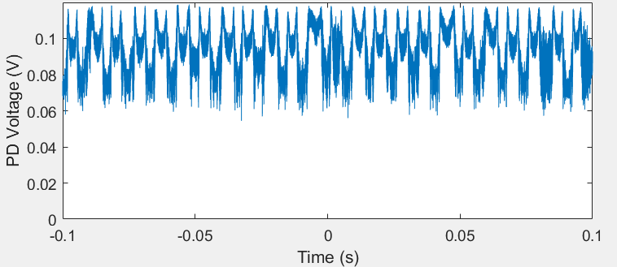
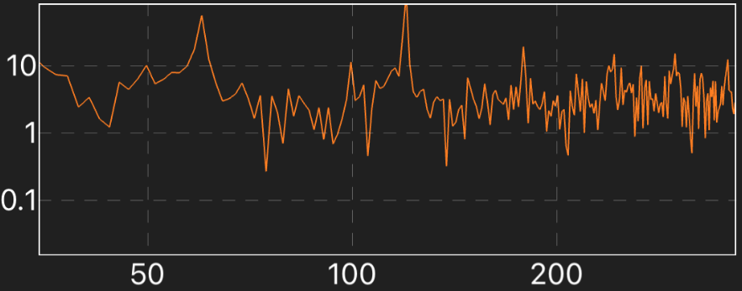
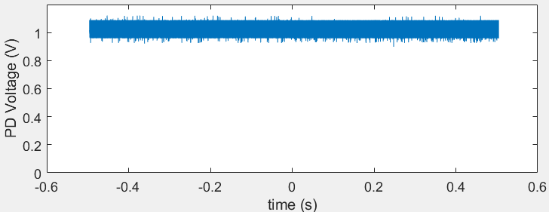
Solution to mode-hopping problem
120 Hz periodical hopping
Caused by the 120 Hz vibration of Tsunami cooling water pump under the table
Stable laser operation for >1 min after turning off the pump
100ms Transmission signal with Tsunami pump on
1s Transmission signal with Tsunami pump off
Acoustic intensity (dB)
60 Hz
120 Hz
Frequency (Hz)

Slide 2
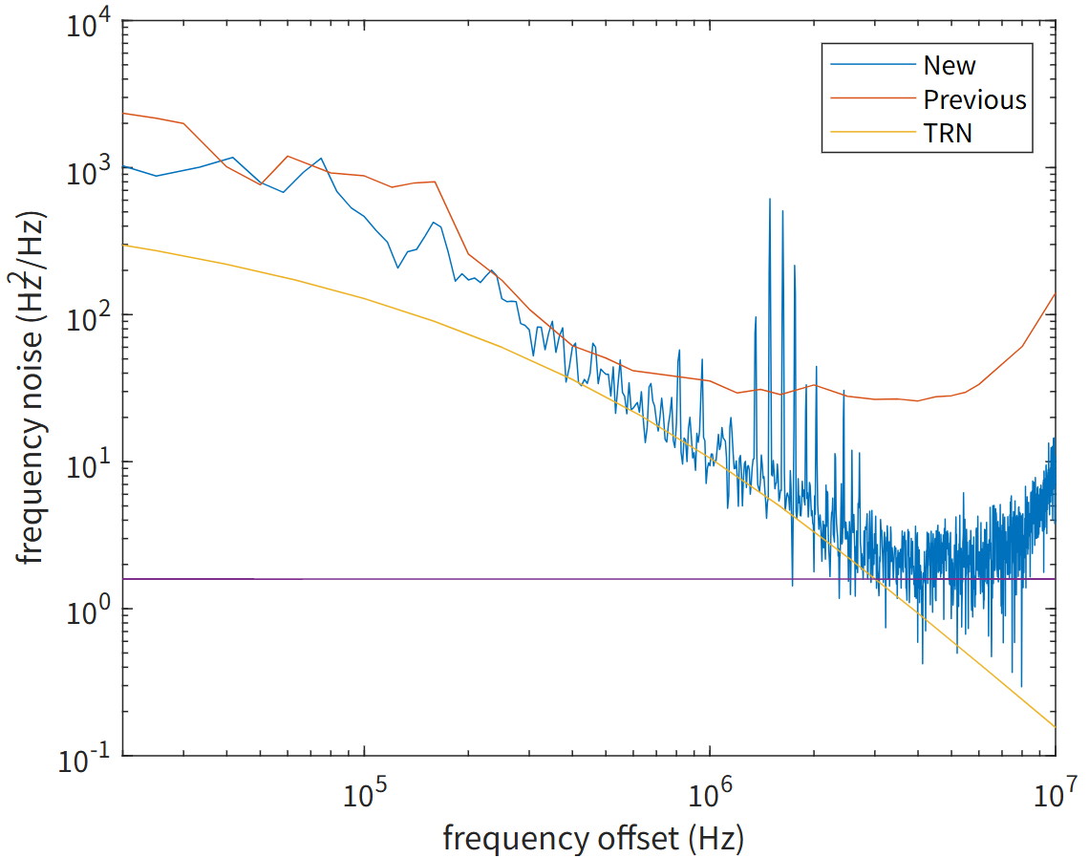
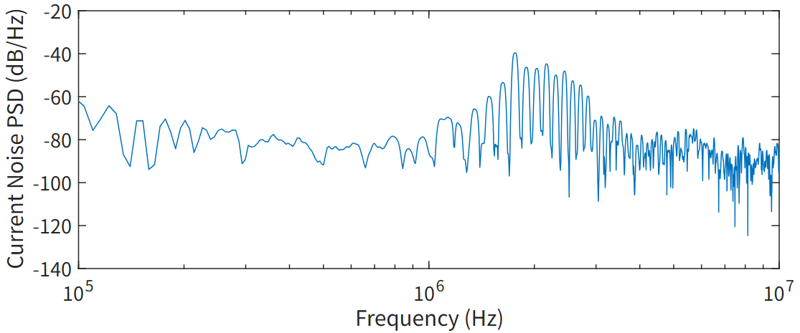
780 SIL optimization
Frequency noise
5 Hz fundamental linewidth
Follows TRN between 300 kHz and 3 MHz
Tricks:
Best coupling efficiency (1.5 mW->4 mW)
Low-noise current source & oscilloscope
Reconstruct code; cross-correlation
FL=5 Hz
current noise

Slide 3
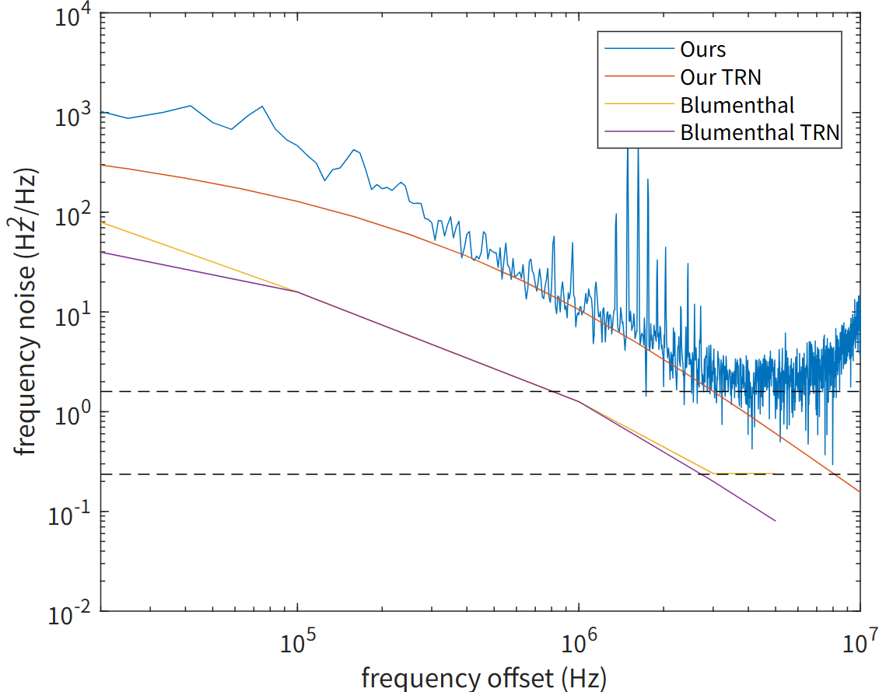
Comparison to state-of-the-art
780 FL record: 0.74 Hz (Blumenthal)
Reason: Small FSR (6 GHz vs 60 GHz)
->~10 dB lower TRN
Possible improvements: better coupling Q, drop port
Records at other wavelengths
Wavelength (nm) | 780 | 652 | 520 | 459
FL record (Hz) | 0.74 | 10k | 26k | 9k
Sci Rep 14, 27015 (2024); Nat. Photon. 17, 157–164 (2023)

