Slide 1
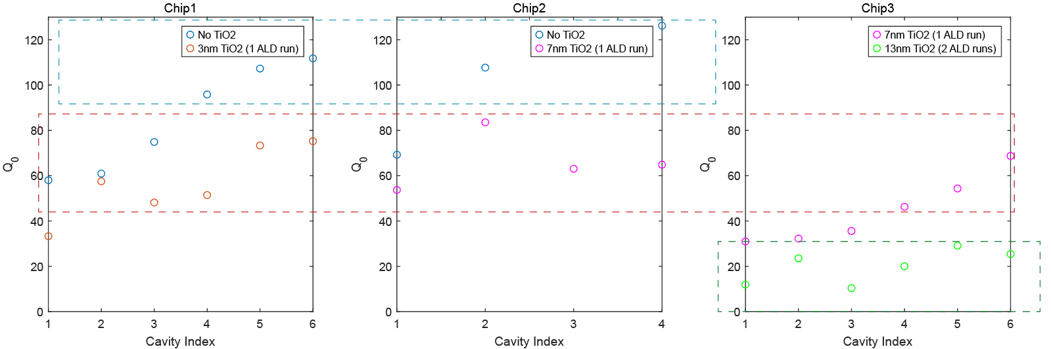
TiO2 device testing
Q drops with TiO2 deposition
Q does NOT drop with wavelength
Q vs TiO2 thickness
It seems ALD affects Q rather than TiO2 absorption
(We could do 450 test)

Slide 2
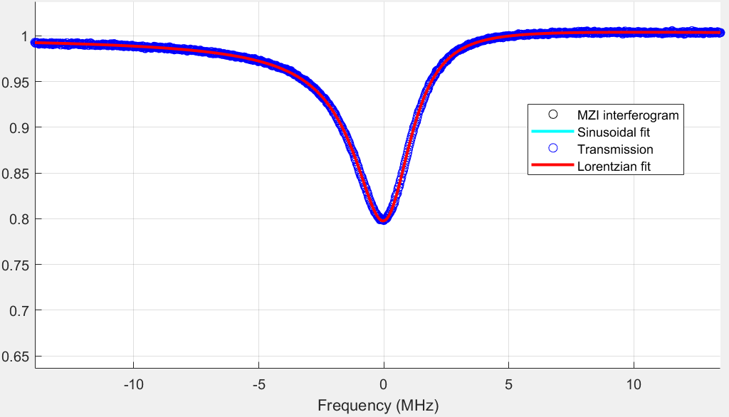
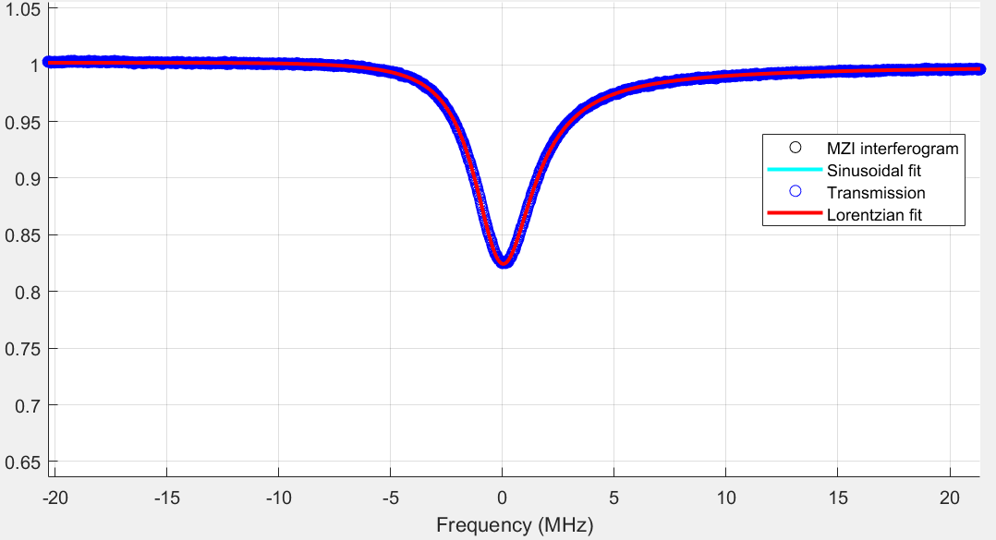
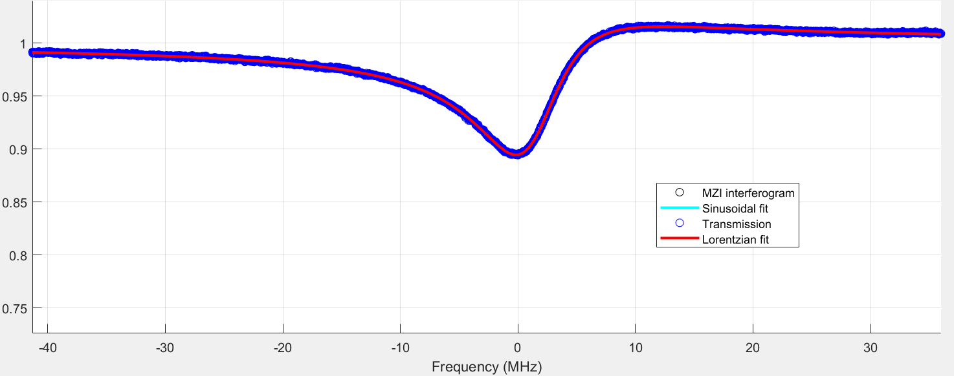
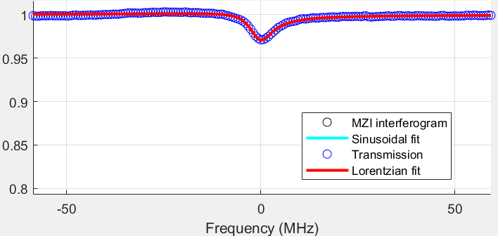
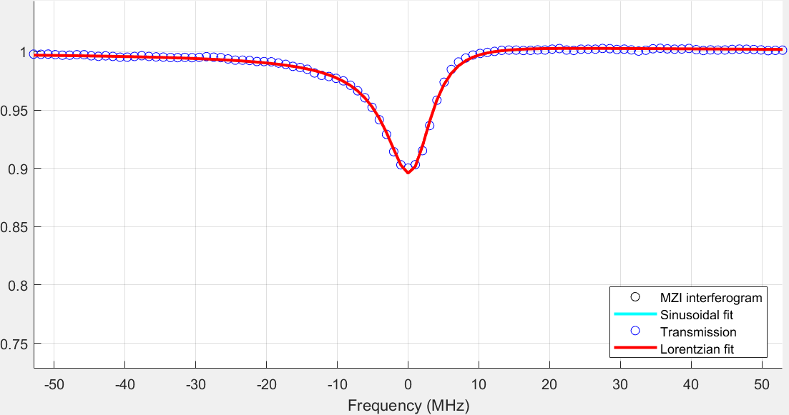
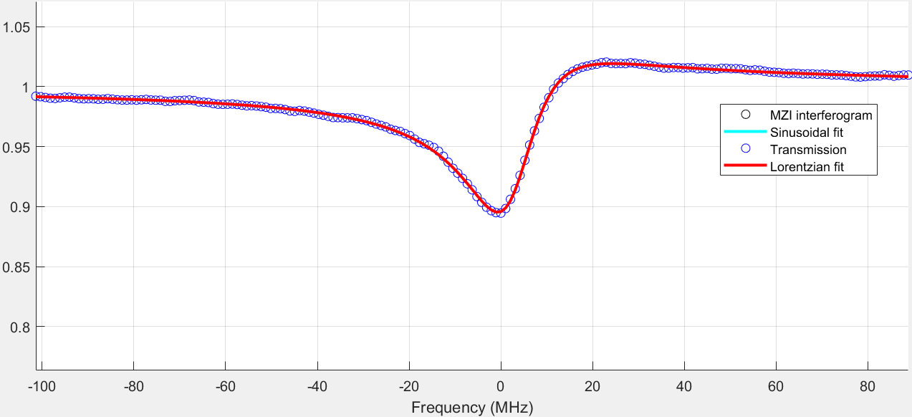
TiO2 device testing
Q drops with TiO2 deposition
Q does NOT drop with wavelength
Q vs wavelength
3 nm
7 nm
13 nm
73.32 M
63.07 M
23.51 M
1550
60.49 M
57.75 M
24.75 M
685
It seems ALD affects Q rather than TiO2 absorption
(We could do 450 test)

Slide 3
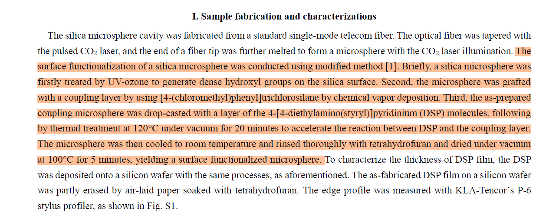
Coating Discussion

Slide 4
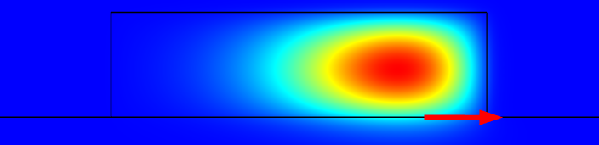
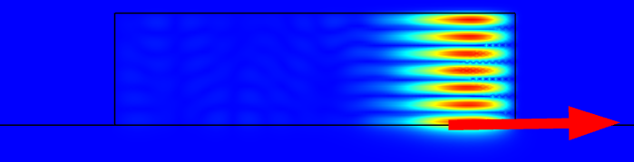
1064 -> 355 design
Impossible with 2% PECVD or sputter:
n(THOX, 355)=1.479 ~ n(2% sputter, 1064)=1.483 > n(2% PECVD, 1064)= 1.474
Possible to reach phase match and good mode overlap with 4% sputter
1064 TE00
Aeff=8123 um^2, overlap factor~0.001
Efficiency 1400%/W^2
UV THG efficiency record in thin film:
10%/W^2 (TiO2-SiO2 metasurface, pulsed excitation)
No demonstration in integrated devices
2.8 um
10 um
355 TE06
Nano Lett. 19, 8972 (2019)

Slide 5
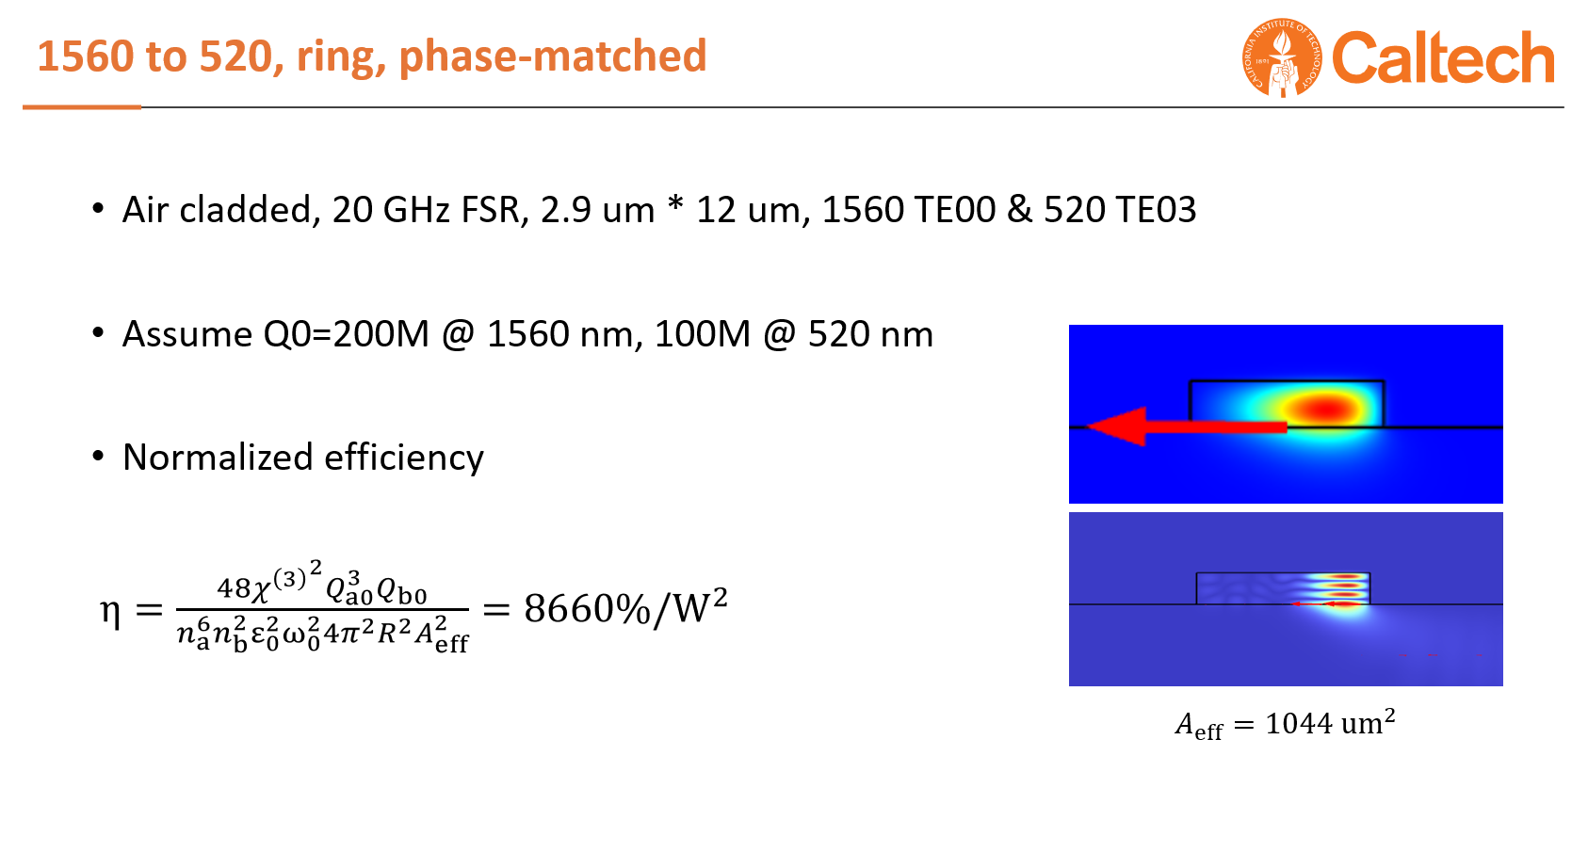
Correction
I forgot to convert to per cent when estimating 1550 THG efficiency last time…
Calculated 1550 efficiency should be 866000%/W^2 rather than 8660%/W^2
Hong Tang experiment: 180%/W^2

Slide 6
THG Milestone?
Option 1: 1560 -> 520, Ge-silica (ambiguous novelty)
Option 2: 1560 -> 520, high-nonlinearity material enhanced (helpful for SUNSPOT, ambiguous novelty)
Option 3: 1064 -> 355, Ge-silica (novel, irrelevant with SUNSPOT scheme)
Option 4: 1064 -> 355, high-nonlinearity material enhanced (novel, relevant, maybe difficult)
For SUNSPOT, option 2&4
For publication, option 3&4

